Slide 1
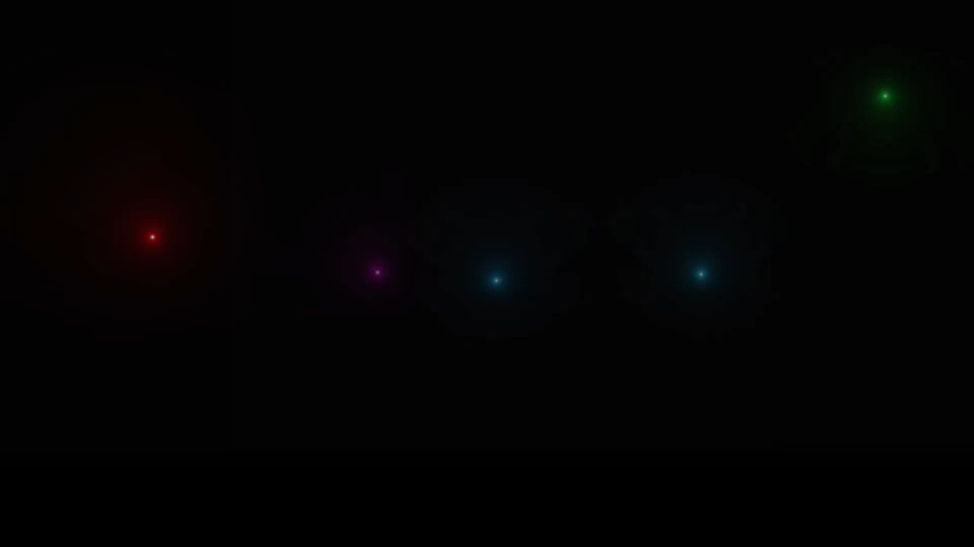

Slide 2

We would like to take this opportunity to thank and acknowledge with due courtesy everyone whose cooperation and encouragement throughout the ongoing course of this project remains invaluable to us.
We are sincerely grateful to our guide Prof. ANAY GHOSH , Associate Professor of the Department of Electronics & Communication Engineering, UEM, Kolkata, for his wisdom, guidance and inspiration that helped us to go through with this project and take it to where it stands now.
We would also like to express our sincere gratitude to Prof. SUKLAYAN GHOSWAMI, HOD, COMPUTER SCIENCE Engineering, UEM, Kolkata and all other departmental faculties for their ever-present assistant and encouragement.
Last but not the least, we would like to extend our warm regards to our families and peers who have kept supporting us and always had faith in our work.

Slide 3
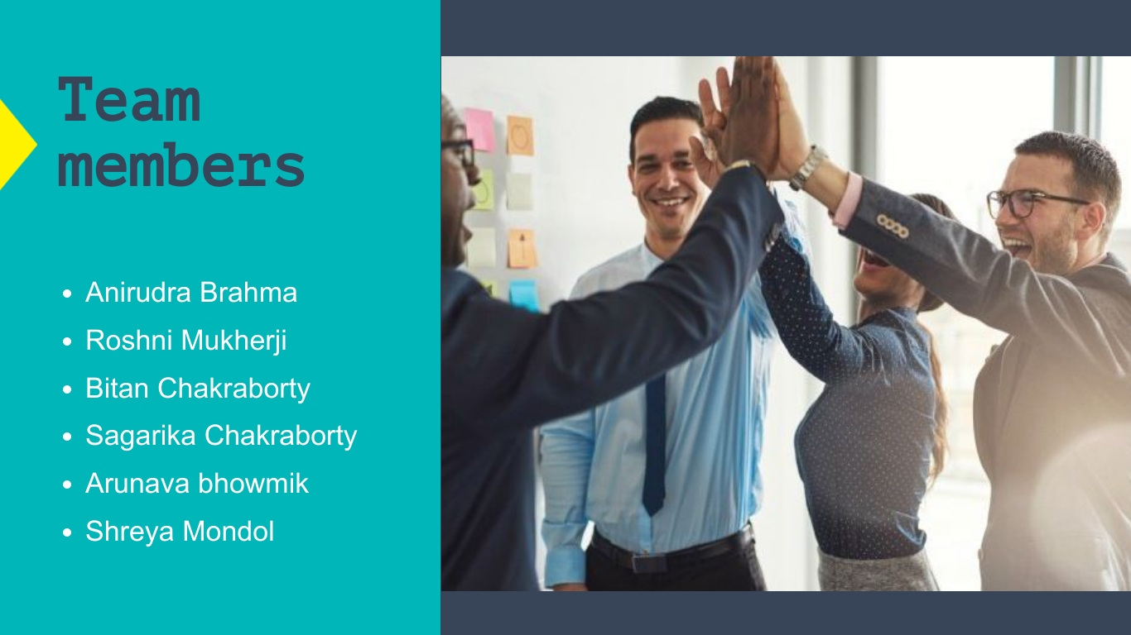

Slide 4
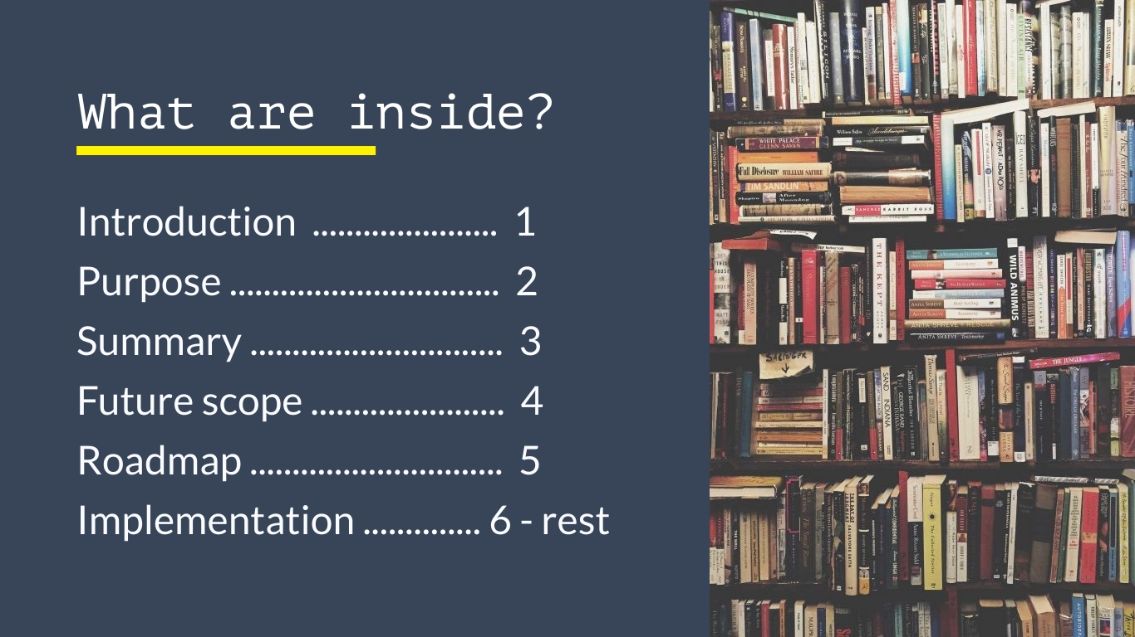

Slide 5
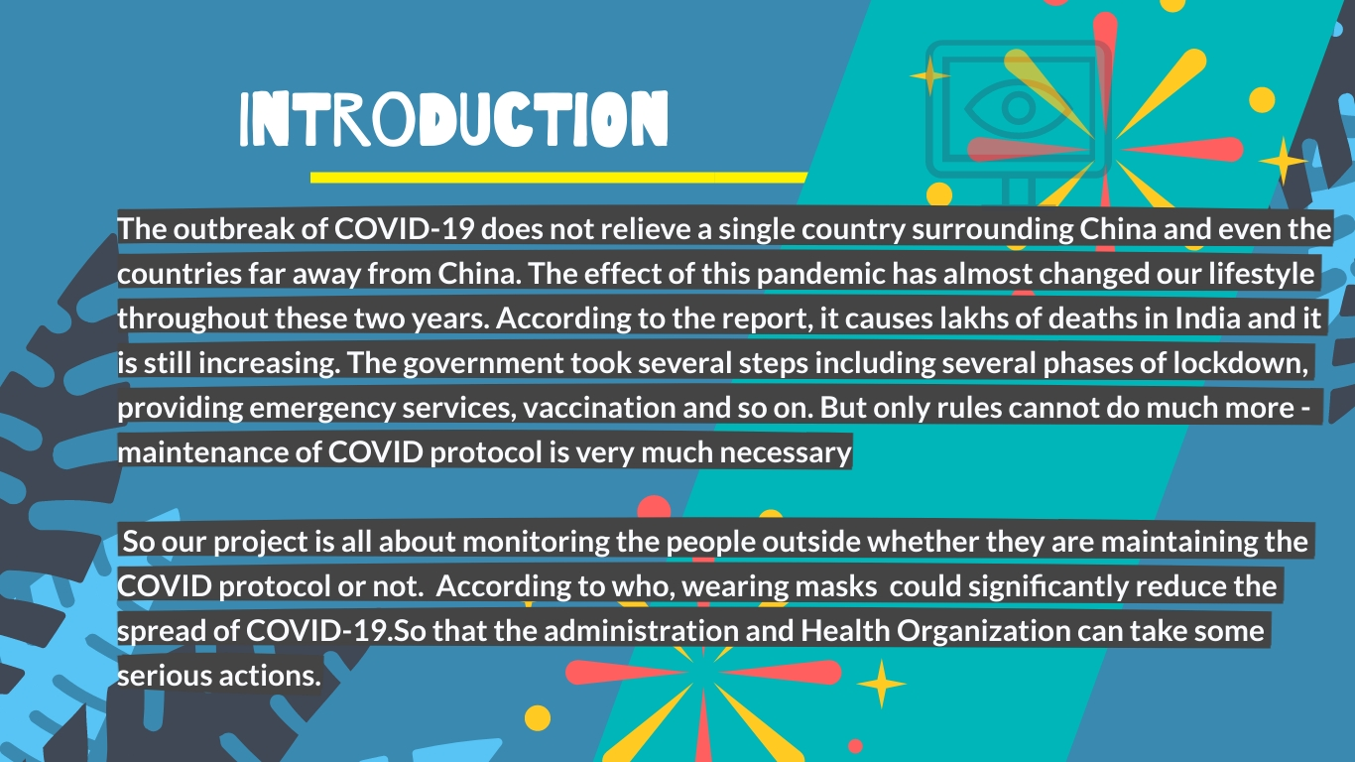

Slide 6
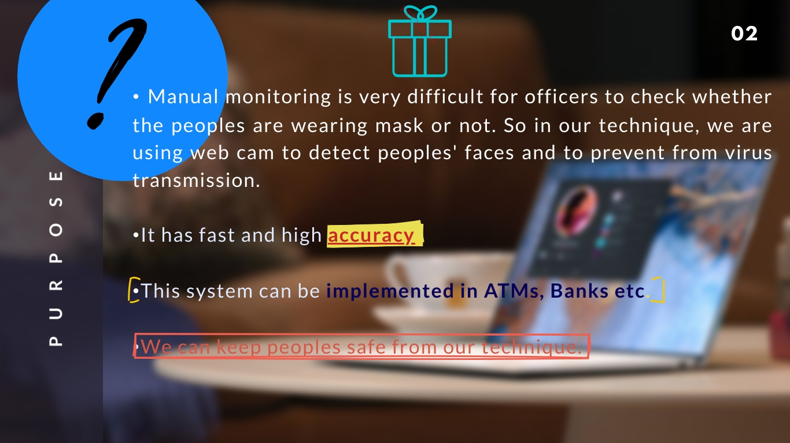

Slide 7
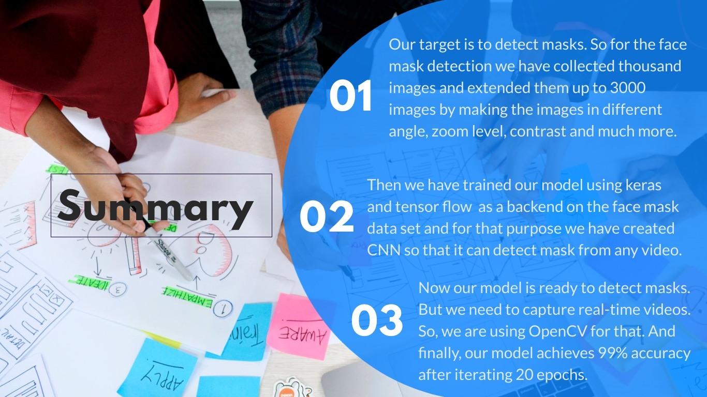

Slide 8
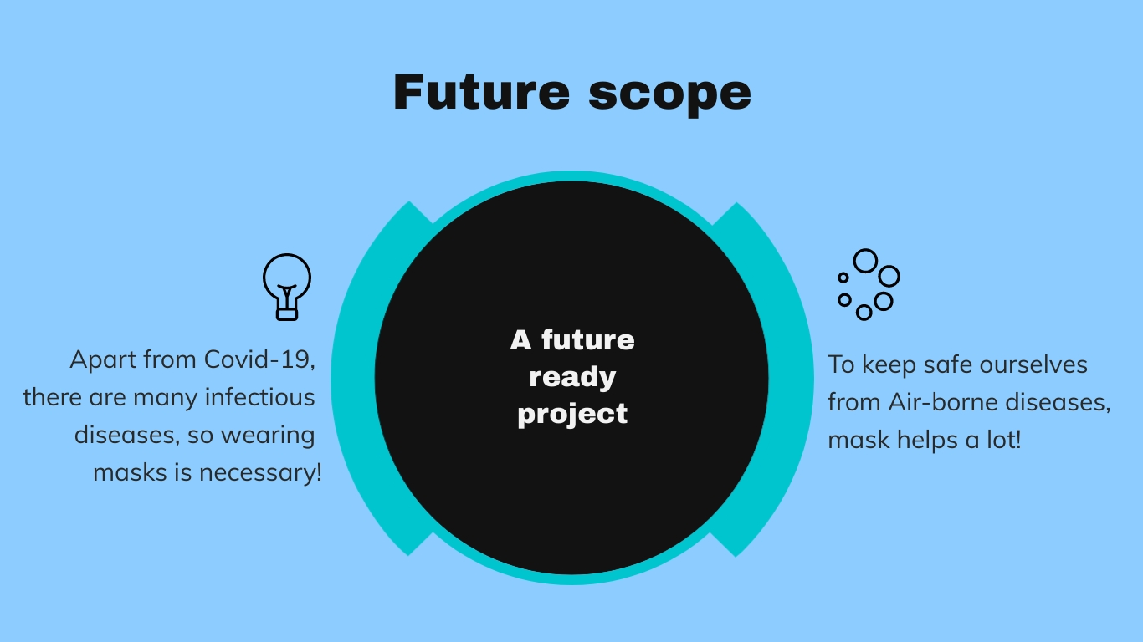

Slide 9
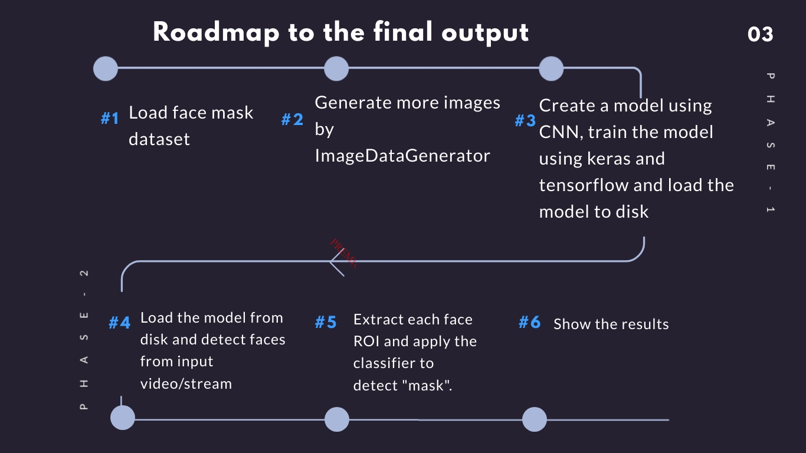

Slide 10
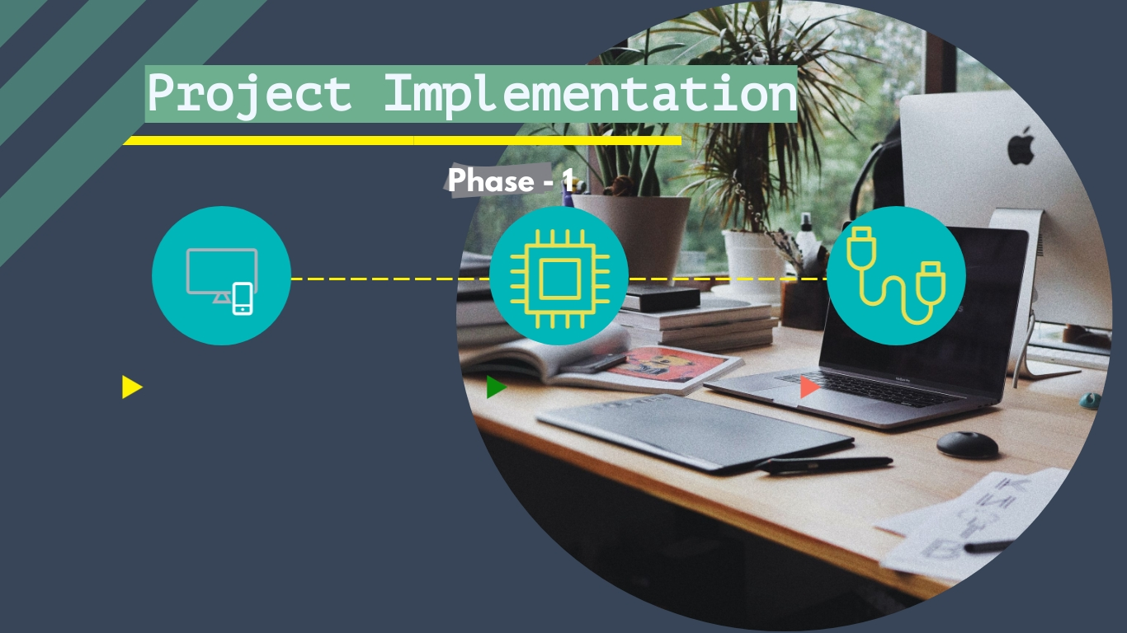
Dataset collection
And extraction
Models
training
Detection of face masks

Slide 11


Data collection and extraction
We’ve constructed the training image generator for data augmentation.
First, we’ve imported the necessary packages
We have run loop all over the layer to stop them from updating during the first training process.
Keras
NumPy
MobileNet
Sklearn
OpenCV
imutils
Then we’ve constructed the head of FC model on top of base model.

Slide 12

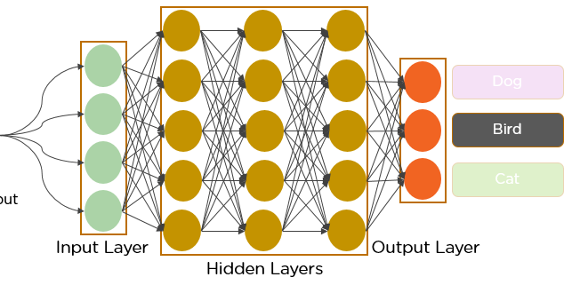
Model training
MobileNet
AveragePooling
Relu
Output

Slide 13
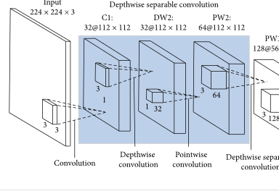
Model training
MobileNet
AveragePooling
Relu
Output

Slide 14
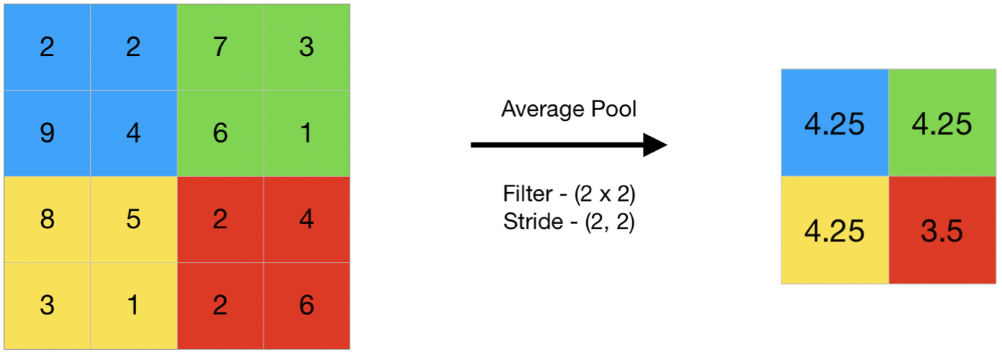
Model training
MobileNet
AveragePooling
Relu
Output

Slide 15

Model training
MobileNet
AveragePooling
Relu
Output

Slide 16


